Slide 1
Association Rules Mining

Slide 2
Basic Concepts of Association Rule Mining
Association rules analysis is a technique to uncover how items are associated to each other.
Association Rule Mining
Finding frequent patterns, associations, correlations, or causal structures among sets of items or objects in transaction databases, relational databases, and other information repositories.
Association rule is defined as an implication of form X->Y where X, Y are called antecedent and consequent of the rule respectively.”

Slide 3
Association Rule Mining
Given a set of transactions, find rules that will predict the occurrence of an item based on the occurrences of other items in the transaction
Market-Basket transactions
Example of Association Rules
{Diaper} → {Beer}
{Milk, Bread} → {Eggs,Coke}
{Beer, Bread} → {Milk},

Slide 4
Applications
Association rules apply to supermarket transaction data, that is, to examine the customer behavior in terms of the purchased products.
Association rules describe how often the items are purchased together.
It has many applications in the field of
data analysis
software bugs
cross-marketing
sale campaign analysis
market basket analysis

Slide 5
Definitions:
Itemset
A collection of one or more items
Example: {Milk, Bread, Diaper}
k-itemset
An itemset that contains k items
Support count (σ)
Frequency of occurrence of an itemset
E.g. σ({Milk, Bread,Diaper}) = 2

Slide 6
Definition:
Support
Fraction of transactions that contain an itemset
E.g. s({Milk, Bread, Diaper}) = 2/5
Frequent Itemset
An itemset whose support is greater than or equal to a minsup threshold

Slide 7
Association Rule
An implication expression of the form X → Y, where X and Y are itemsets
Example: {Milk, Diaper} → {Beer}
Rule Evaluation Metrics
Support (s)
Fraction of transactions that contain both X and Y
Confidence (c)
Measures how often items in Y appear in transactions that contain X

Slide 8
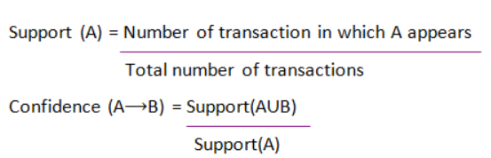
Support and Confidence for Itemset A and B are represented by formulas:

Slide 9
Support and Confidence can be represented by the following example:
Bread=> butter [support=2%, confidence-60%]
The above statement is an example of an association rule.
This means that there is a 2% transaction that bought bread and butter together
and there are 60% of customers who bought bread as well as butter.

Slide 10
Example of support and Confidence
Consider an association rule
:

Slide 11
What Is A Frequent Itemset?
A set of items is called frequent if it satisfies a minimum threshold value for support and confidence.
Support shows transactions with items purchased together in a single transaction.
Confidence shows transactions where the items are purchased one after the other.
For frequent itemset mining method, we consider only those transactions which meet minimum threshold support and confidence requirements.

Slide 12
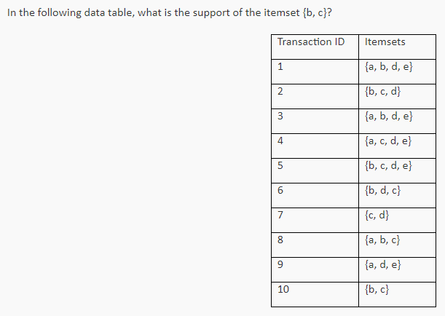
Problem 1

Slide 13
Problem 1-answer
Support count of {b,c}=5
Total transactions =10
Support=5/10= 0.5

Slide 14
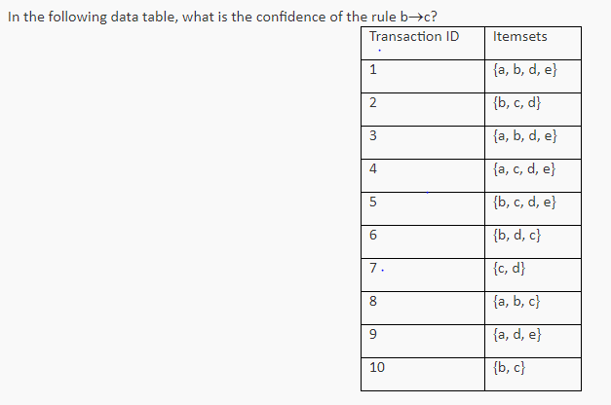
Problem 2

Slide 15
Problem 2
Support count of {b,c}=5
Support count of {b}=7
Confidence=5/7

Slide 16
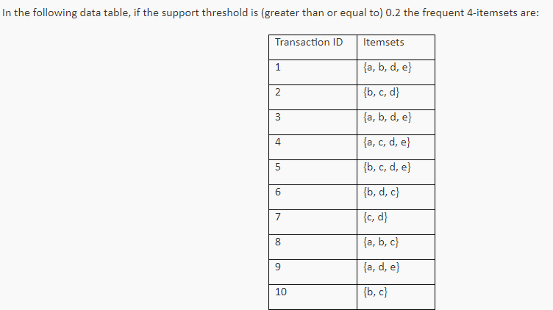
Problem 3
Hint:
Find the support of all frequent 4 item set.
Those having support 0.2 or greater will be the answer

Slide 17
Problem 3-answer
Answer :{a,b,d,e}

Slide 18
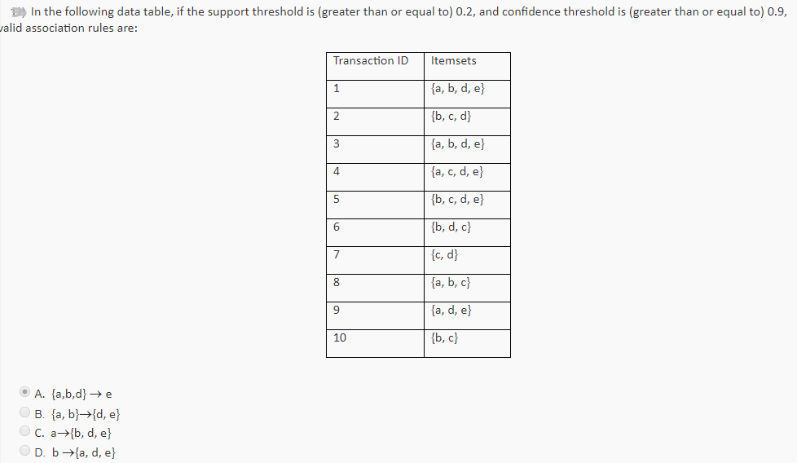
Problem 4
Hint:
Find the support and confidence of all 4 rules.
Those rules having support 0.2 or greater and confidence 0.9 or greater are valid rules

Slide 19
Association Rule Mining Task
Given a set of transactions T, the goal of association rule mining is to find all rules having
support ≥ minsup threshold
confidence ≥ minconf threshold
Brute-force approach:
List all possible association rules
Compute the support and confidence for each rule
Prune rules that fail the minsup and minconf thresholds

Slide 20
Mining Association Rules
Two-step approach:
Frequent Itemset Generation
Generate all itemsets whose support ≥ minsup
Rule Generation
Generate high confidence rules from each frequent itemset, where each rule is a binary partitioning of a frequent itemset

Slide 21
Frequent Item set Generation Algorithms
1. Apriori Algorithm
2.FP growth

Slide 22
Apriori Algorithm – Frequent Pattern Algorithms
Apriori algorithm was the first algorithm that was proposed for frequent itemset mining.
It was later improved by R Agarwal and R Srikant and came to be known as Apriori.
This algorithm uses two steps “join” and “prune” to reduce the search space.
It is an iterative approach to discover the most frequent itemsets.

Slide 23
The steps followed in the Apriori Algorithm of data mining are:
Join Step:
This step generates (K+1) itemset from K-itemsets by joining each item with itself.
Prune Step:
This step scans the count of each item in the database.
If the candidate item does not meet minimum support, then it is regarded as infrequent and thus it is removed.
This step is performed to reduce the size of the candidate itemsets.

Slide 24
Frequent Itemset Generation
Given d items, there are 2^{d} -1 possible candidate itemsets

Slide 25
The Apriori Algorithm : Pseudo code
Join Step: C_{k} is generated by joining L_{k-1}with itself
Prune Step: Any (k-1)-itemset that is not frequent cannot be a subset of a frequent k-itemset
Pseudo-code:
C_{k}: Candidate itemset of size k
L_{k} : frequent itemset of size k
L₁ = {frequent items};
for (k = 1; L_{k} !=∅; k++) do begin
C_{k+1} = candidates generated from L_{k};
for each transaction t in database do
increment the count of all candidates in C_{k+1} that are contained in t
L_{k+1} = candidates in C_{k+1} with min_support
end
return ∪_{k} L_{k};

Slide 26
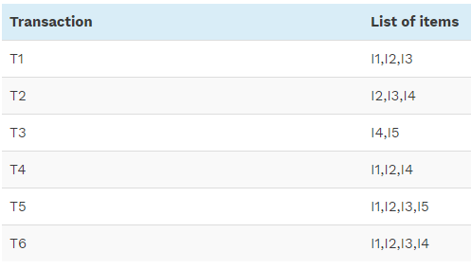
Example of Apriori: Support threshold=50%, Confidence= 60%
Consider the set of transactions with minimum support count is 3

Slide 27
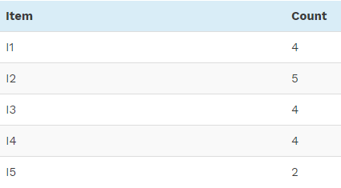
1. Count Of Each Item TABLE-2
C1

Slide 28
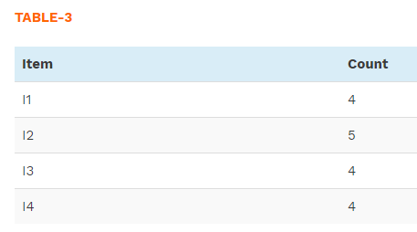
2. Prune Step (Generating frequent 1 itemset-L1) TABLE -2 shows that I5 item does not meet min_sup=3, thus it is deleted, only I1, I2, I3, I4 meet min_sup count.
L1

Slide 29
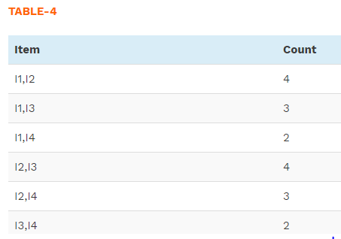
3. Join Step: Form 2-itemset from from TABLE-3 and find out the occurrences of 2-itemset.
C2 (Formed by L1 join L1)

Slide 30
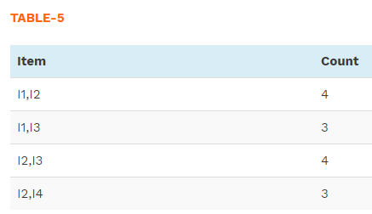
4. Prune Step:(Generating frequent 2 itemset-L1) TABLE -4 shows that item set {I1, I4} and {I3, I4} does not meet min_sup, thus it is deleted.
L2

Slide 31
5. Join Step: (L2 join L2) Form 3-itemset.
From the TABLE- 5 find out occurrences of 3-itemset.
In table 5 there are 4 items I1,I2,I3,I4 and
3 –item set are
I1, I2, I3
I1, I2, I4
I1 ,I3 ,I4
I2, I3, I4

Slide 32
5. Join Step:
Item | Count
I1,I2,I3 | 3
I1,I2,I4 | 2
I1,I3,I4 | 1
I2,I3,I4 | 2
C3 (Formed by L2 join L2)

Slide 33
6.PRUNE STEP
Item | Count
I1,I2,I3 | 3
L3
Only {I1, I2, I3} is frequent.

Slide 34
Generate Association Rules:
3 STEPS
List all possible association rules
Compute the support and confidence for each rule
Prune rules that fail the minsup and minconf thresholds (in this eg: min Support threshold=50% and min Confidence threshhold = 60%)

Slide 35
Generate Association Rules: Step 1: List all possible association rules
From the frequent itemset I1 ,I2,I3
the following association rules can be generated
I1, I2 => I3
I1, I3 => I2
I2, I3 => I1
I1 => I2,I3
I2 =>I1, I3
I3 =>I1, I2

Slide 36
Generate Association Rules: Step 2:Compute the support and confidence for each rule
Support of all rules are 3/6*100= 50 %
Next we need to calculate the confidence of all rules
Rule 1:
I1, I2 => I3, Confidence = supportcount{I1, I2, I3} / support {I1, I2} = (3/ 4)* 100 = 75%
Rule 2:
I1, I3 => I2,Confidence = support {I1, I2, I3} / support {I1, I3} = (3/ 3)* 100 = 100%
Rule 3:
I2, I3 => I1, Confidence = support {I1, I2, I3} / support {I2, I3} = (3/ 4)* 100 = 75%

Slide 37
Generate Association Rules: Step 2:Compute the support and confidence for each rule
Rule 4:
I1 => I2,I3, Confidence = support {I1, I2, I3} / support {I1} = (3/ 4)* 100 = 75%
Rule 5:
I2 =>I1, I3, Confidence = support {I1, I2, I3} / support {I2 = (3/ 5)* 100 = 60%
Rule 6:
I3 =>I1, I2, Confidence = support {I1, I2, I3} / support {I3} = (3/ 4)* 100 = 75%

Slide 38
Generate Association Rules: Step 3: Prune rules that fail the minsup and minconf thresholds
In this example all rules satisfy minimum support and confidence criteria.
(Support threshold=50%, Confidence= 60%)
Hence all rules (Rule1 to Rule 6 ) are valid .

Slide 39
Shortcomings Of Apriori Algorithm
Using Apriori needs a generation of candidate itemsets. These itemsets may be large in number if the itemset in the database is huge.
Apriori needs multiple scans of the database to check the support of each itemset generated and this leads to high costs.
These shortcomings can be overcome using the FP growth algorithm.

Slide 40
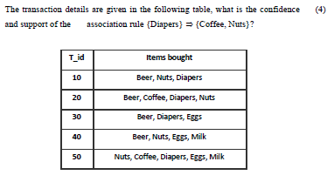
University question

Slide 41
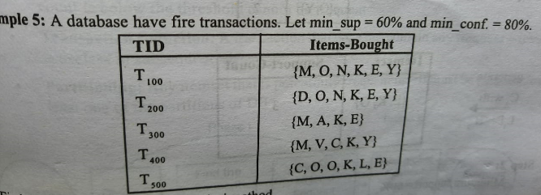
Find the strong association rules

Slide 42
To find minimum support count
Minimum Support Count= total number of transactions*support
If the number of transactions is 5 and support is 60% ,then minimum support count would be 5*60/100 = 3.

Slide 43
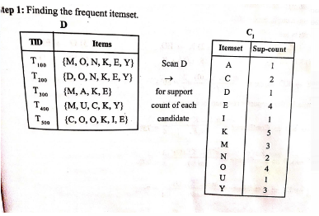

Slide 44
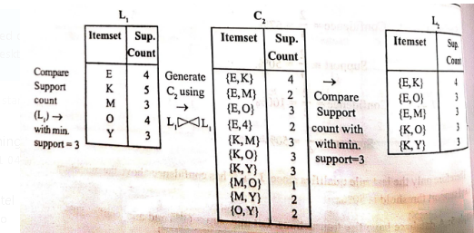

Slide 45
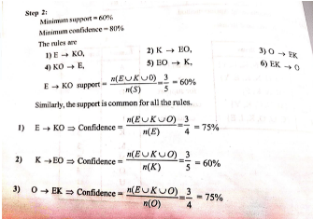

Slide 46
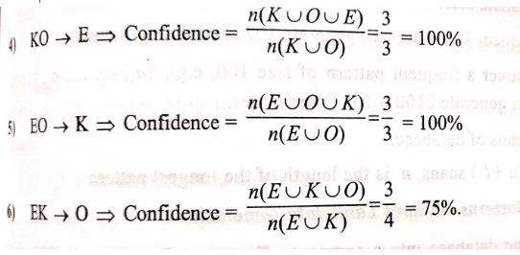

Slide 47
Market Basket Analysis
Market Basket Analysis is one of the key techniques used by large retailers to uncover associations between items.
They try to find out associations between different items and products that can be sold together, which gives assisting in right product placement.
Typically, it figures out what products are being bought together and organizations can place products in a similar manner.
Let’s understand this better with an example:
People who buy Bread usually buy Butter too.
The Marketing teams at retail stores should target customers who buy bread and butter and provide an offer to them so that they buy the third item, like eggs.
So if customers buy bread and butter and see a discount or an offer on eggs, they will be encouraged to spend more and buy the eggs. This is called market basket analysis

Slide 48
Problem 2
TID | List of Items
T100 | I1, I2, I5
T100 | I2, I4
T100 | I2, I3
T100 | I1, I2, I4
T100 | I1, I3
T100 | I2, I3
T100 | I1, I3
T100 | I1, I2 ,I3, I5
T100 | I1, I2, I3
Suppose min. support count required is 2 (i.e. min_sup = 2/9 = 22 % )
Let minimum confidence required is 70%.

